Slide 1


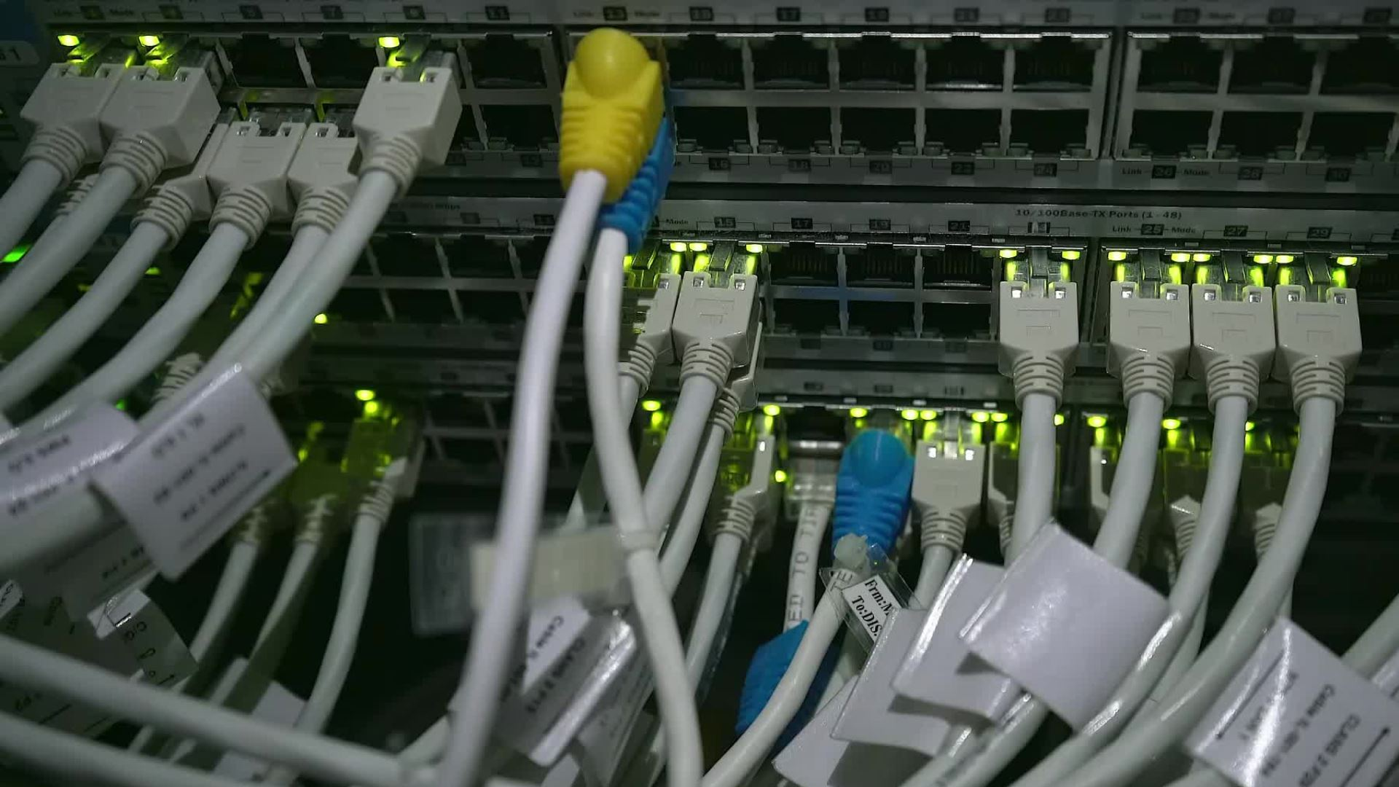
LAND REGISTRATION SYSTEM USING BLOCKCHAIN(ETHEREUM)
Name - Dev SINGHMAR
Roll no - 21it3017
Mentor name – DR. GARGI SRIVASTAVA

Slide 2
Table OF CONTENTS-
Problem Statememnt
Proposed Approach
Architecture of System
Samples and Results
Conclusion
Future Scope

Slide 3
Problem Statement
The current system for land registration is full of duplicity and inefficiencies, due to which the land records are not protected, and citizens are the one those have to bear the most of it.
Almost 66% court cases in the country are related to land disputes costing a whopping Rs.58,000 crore in litigation

Slide 4
Proposed Approach
Implement a private and permissioned blockchain system leveraging cryptographic security and consensus algorithms.
Develop transactional processes ensuring secure, validated, and transparent land registration.
Enable user and land registration functionalities, incorporating verification checks by the government and registrar.
Facilitate smooth ownership changes with mandatory verification steps and associated financial transactions.

Slide 5
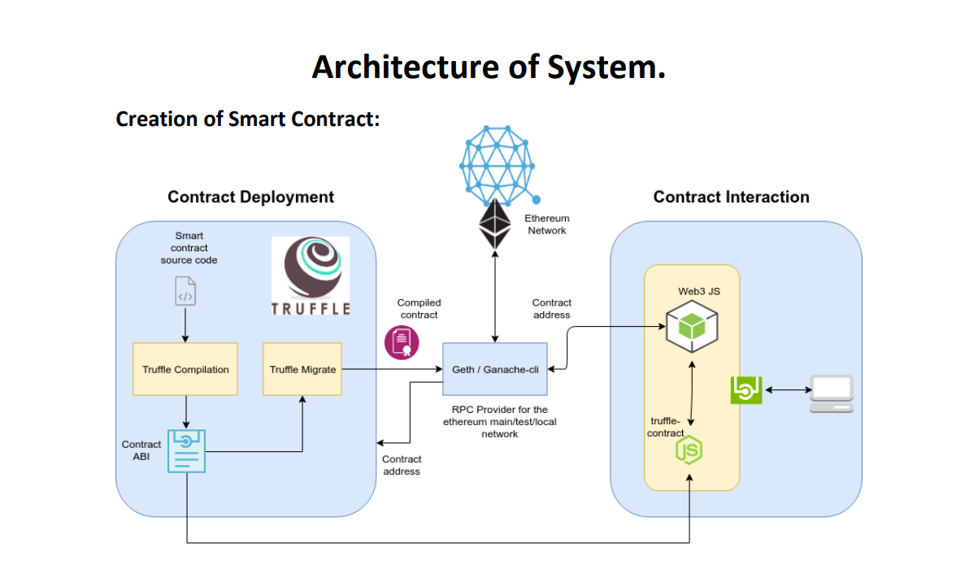

Slide 6
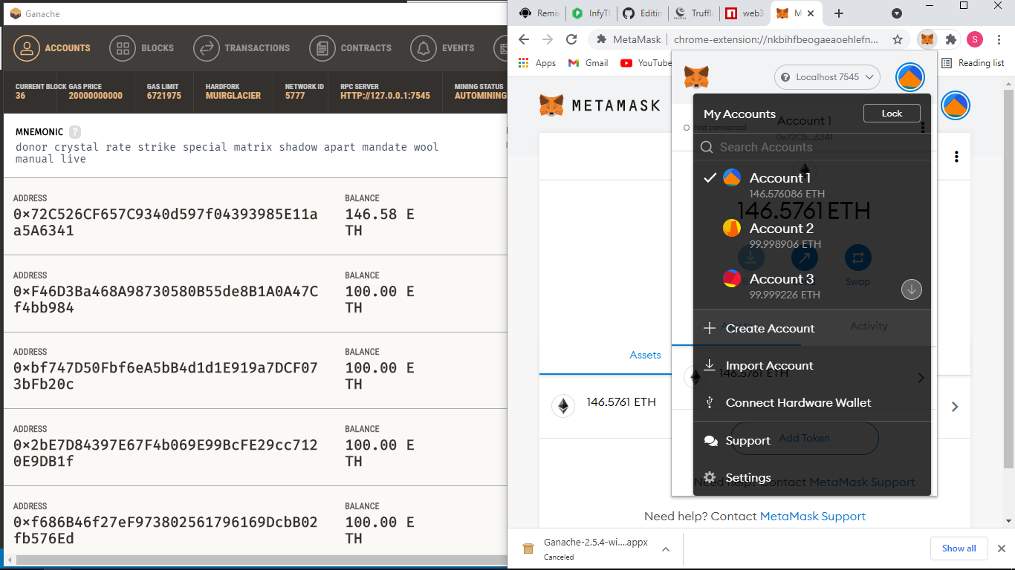
Ganache blockchain tool and METAMASK connection

Slide 7
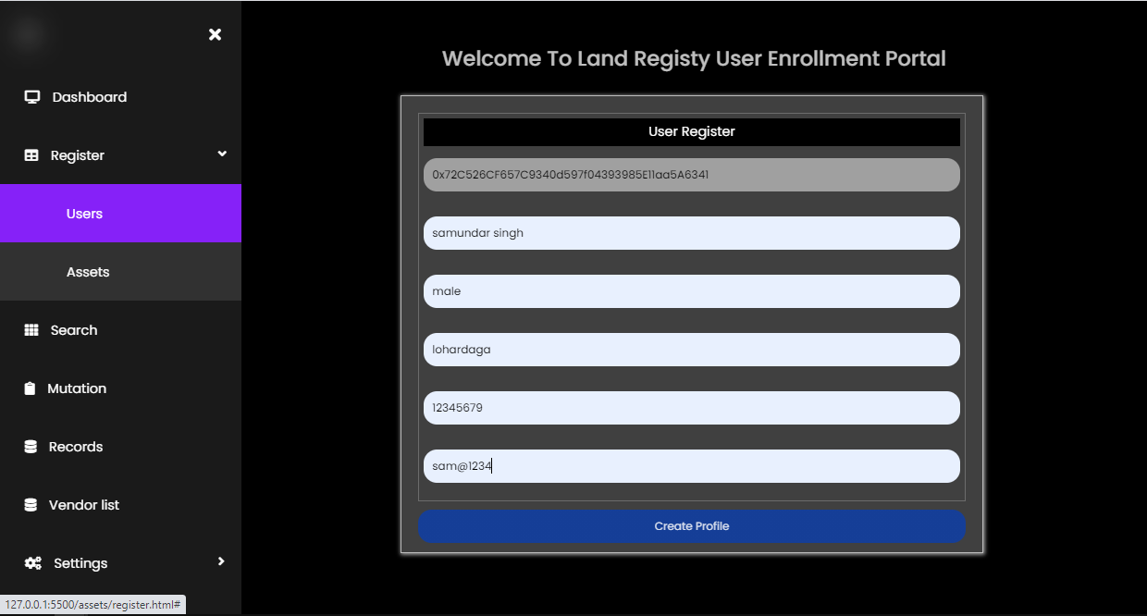
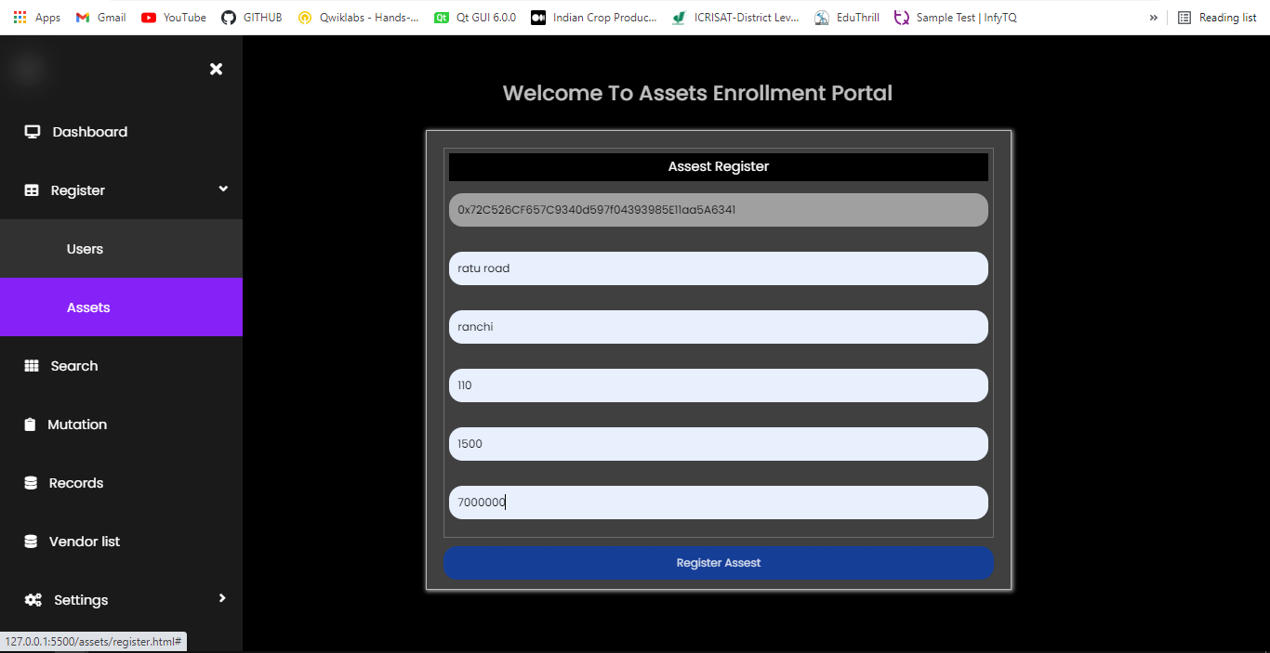
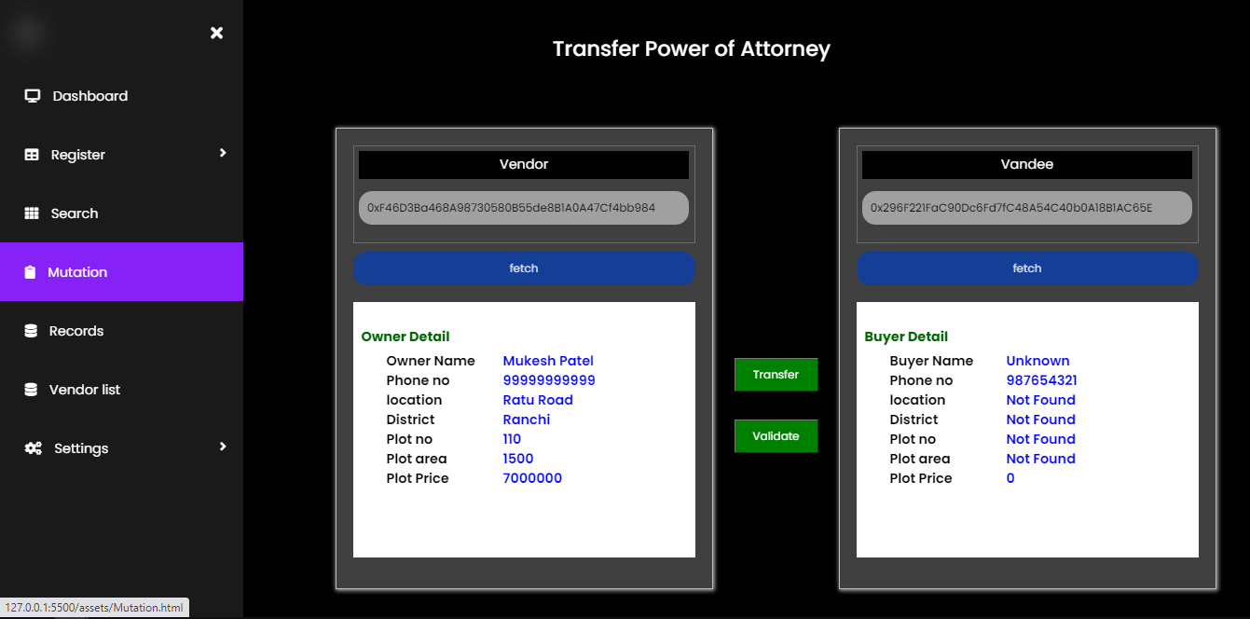
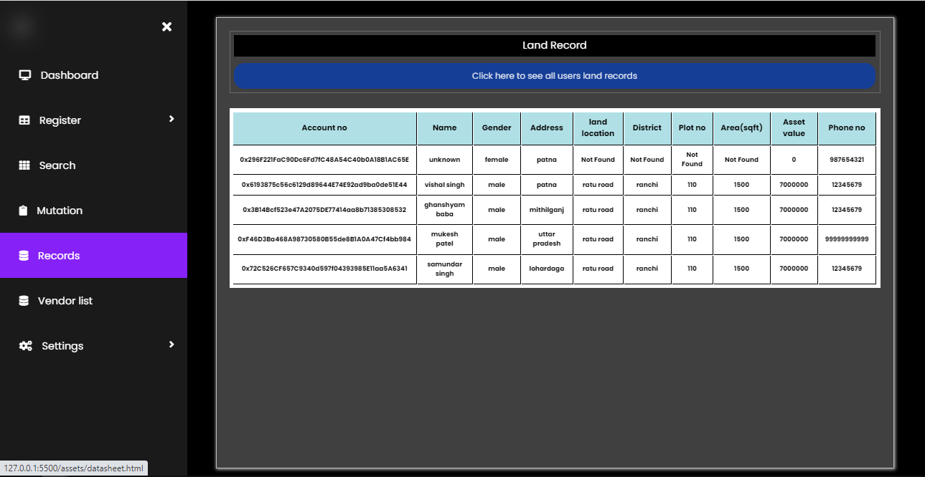
WEBSITE OVERVIEW SAMPLES

Slide 8
Conclusion
Blockchain is one of the most secure ways of storing data without it being changed. It is a distributed ledger that is open to anyone and once data is put into it, it is very difficult to change it.
Using this property of blockchain we want to put it to use into one of the most fraudulent systems in India, the Land Registration System.
This gives rise to a system that is more evolved and features all the activities like buying and selling in an efficient and reliable way. Blockchain technology made this system secure and faster.
If this kind of system is upgraded further and integrated with useful API then this will lead to faster transactions and will eventually lead to easement of the entire process, thus making the entire system hassle free and convenient in the long run which would be beneficial to the mankind.

Slide 9

Future Scope
As our implemented system is currently subjected to deployment of transactions where we directly make use of all the documents which are already verified manually by the authority, in future our scope could be expanded by integrating our system with government API. By doing so we can verify the users and their deeds automatically in a simple manner.
Incorporation of a language translation tool can be done to users who speak their native languages.
Add various dimensions to our system and thus making it more reliable and user friendly.

